Slide 1


KRAKEN QGIS PLUGIN • USER MANUAL
Spider Graph Map Tool
Interactive GIS visualization connecting Measurement Report (MR) points to serving cells with high-performance DuckDB querying and dynamic styling engine.
ENGINE
RENDERING
SUPPORT
DuckDB SQL
Dual Layer GIS
LTE Multi-Value
Kraken © 2026 | akanipatra@gmail.com

Slide 2

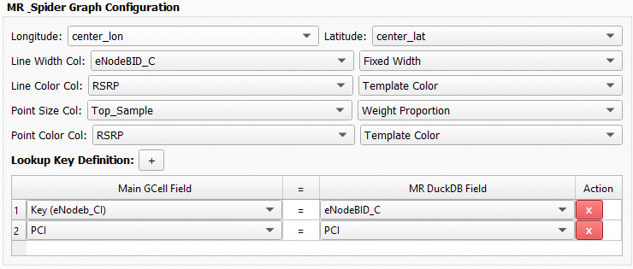
STEP 01 • INITIAL SETUP
Configuration & Data Mapping
Configure DuckDB paths, column mapping, and field lookup definitions in Setting Tab 4.
1. DuckDB MR Storage
High-speed DuckDB file containing Measurement Report samples with latitude and longitude data.
2. Dynamic Attribute Selectors
Assign columns for Line Width, Line Color, Point Size, and Point Color metrics.
3. Multi-Key Lookup Definition
Link Main GCell layer keys (e.g., eNodeB_CI, PCI) directly to MR DuckDB fields.
Kraken © 2026 | akanipatra@gmail.com

Slide 3
STEP 02 • INTERACTIVE MAP TOOL
Canvas Click & Execution Workflow
On-demand spider line generation with automatic coordinate transform and state cleanup.
01
02
03
Activate Map Tool
Pick Target Cell
Auto-Purge & Render
Select the Spider Tool on the toolbar. Cursor switches to pointing hand, ready to pick cell features from the active layer.
Click on any cell sector. Tool identifies top feature, extracts centroid, and transforms geometry to EPSG:4326.
Prevents map cluttering by automatically purging previous spider lines before rendering new vector layers.
setCursor(PointingHand)
QgsCoordinateTransform
removeMapLayer()
Handles multi-value string arrays with automatic normalization (e.g. '40.0' to '40').
DUCKDB LIKE QUERY
Kraken © 2026 | akanipatra@gmail.com

Slide 4
STEP 03 • VISUAL ENGINE
Dynamic Rendering & Styling Modes
Flexible color and sizing modes for spider lines and MR measurement points.
Fixed Styling
Weight Proportion
Auto Range
Template Color
Uniform width/size and color across all rendered vector graphics.
Equal interval breaks across 5 proportional traffic bands (0-100%).
Quantile scale classification adaptively adjusted to actual dataset values.
Graduated color palette based on standard RF metrics (e.g. RSRP dBm).
DEFAULT RSRP COLOR SCALE TEMPLATE
≤ -115 dBm
-115 to -105
-105 to -95
-95 to -85
-85 to -75
> -75 dBm
Very Poor
Poor
Fair
Good
Very Good
Excellent
Kraken © 2026 | akanipatra@gmail.com

Slide 5

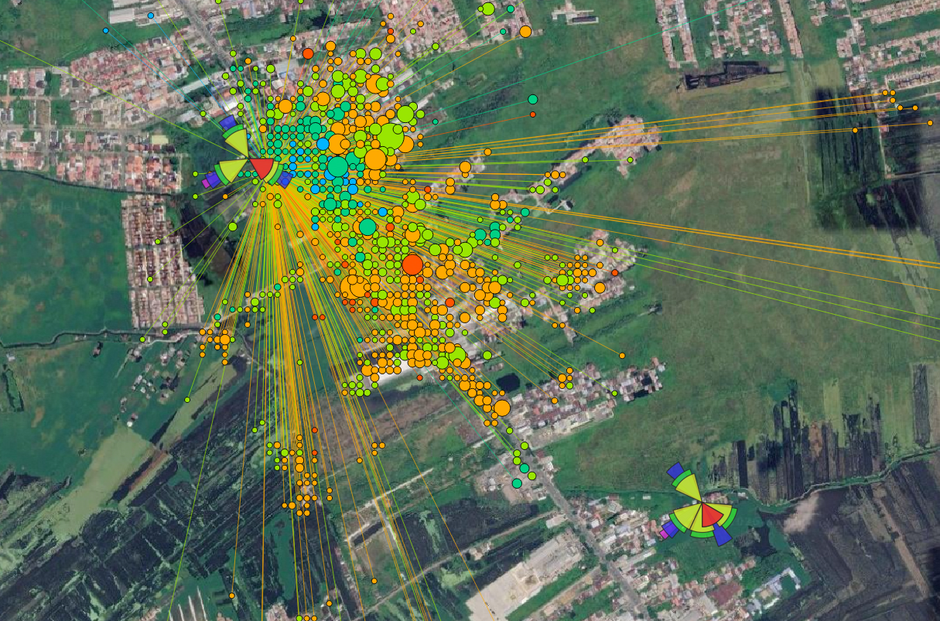
STEP 04 • ANALYTICS CANVAS
GIS Layer Generation & Analysis
Generated memory layers with automated geodesic distance calculation.
Spider_Lines_{Cell_ID}
LineString EPSG:4326
Stores connection lines between serving cell and MR points. Contains exact geodesic distance (Dist_m) calculated via WGS84 ellipsoid.
Spider_Points_{Cell_ID}
Point EPSG:4326
Represents MR locations with full attribute mapping for sample weight and signal quality color scale.
Success status bar notification displayed instantly upon layer creation.
Kraken © 2026 | akanipatra@gmail.com

